Slide 1
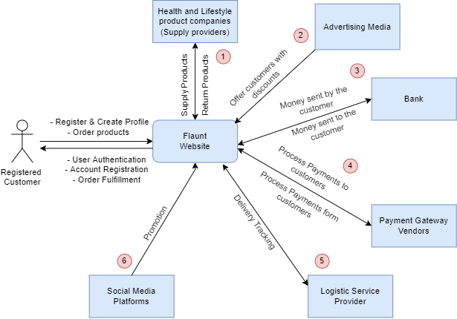
Flaunt Context Diagram

Slide 2
System Interface Table
No. | Description | Source | Target | Frequency | Validation
1 | Supply Products | Health and Lifestyle product companies (Supply Providers) | Flaunt Website | Real- time | The brands would send the required products as per Flaunt’s product categories.
 | Return Products | Flaunt Website | Health and Lifestyle Product Companies | Real-Time | Flaunt would resend the products returned by the customer to the suppliers
2 | Offer Customers with discount | Advertising Media | Flaunt Website | Real-Time | Offers customers with coupons and Gift cards according to their purchased Items
3 | Maintain Flaunt’s bank Account from the money sent by the Customer | Bank | Flaunt Website | Real- time | It helps Flaunt to maintain the purchase history and for the amount received from the customer’s purchase
 | Maintain Flaunt’s bank account for the money sent to the customer | Flaunt Website | Bank | Real-Time | It would help flaunt to maintain record in terms of money when a customer returns and asks for a refund.
4 | Process Payments from customers | Payment Gateway Vendors | Flaunt Website | Real- time | The payment vendors would be helping flaunt to get the payments from the customers to the bank account
 | Process payments to customers | Flaunt website | Payment gateway vendors | Real-time | The payment vendors would be helping flaunt to send back the payments from flaunts account to customers bank account in case of a refund.

Slide 3
System Interface Table
No. | Description | Source | Target | Frequency | Validation
5 | Delivery Tracking for the customer | Logistic Service Provider | Flaunt Website | Real- time | Helps Flaunt to deliver the products to the customer’s doorsteps and also helps them to track the product in real-time.
 | Delivery Tracking for the flaunt | Flaunt | Logistic Service Provider | Real-time | Would help flaunt to procure and track an item if it is being returned by the customer
6 | Promotion | Social Media Platforms | Flaunt Website | Real-Time | Content creators and influencers collaborate to buoyant the total reach of Flaunt products into the market using social media.

